Slide 1
Railroad Crossings In TIMS
2016 NCPTA Summer Conference

Slide 2
Railroad Crossings Update
It is imperative that each LEA review the railroad crossing data in their TIMS map by the annual TDTIMS data audit due Tuesday, November 1, 2016
This data is needed to calculate how many students cross any Railroad Crossing in NC as an aid to determine which crossings are upgraded
Data is also used in TIMS to give the driver a warning of a Railroad Crossing in their driver directions
TIMS staff, partnering with the NC DOT Railroad Division, have found many errors in the current data and a thorough review is necessary

Slide 3
Example of Railroad Crossing in a Run Direction Report
Turnaround on SWAIN COUNTY WEST ELEMENTARY SCH DR
Turn Left on HWY 19 74 W
Turn Left on VETRANS RAMP
Turn Left on VETERANS BLVD
Turn Right on MAIN ST
Turn Left on EVERETT ST
Proceed on EVERETT ST
*RR XING*720196J
*RR XING*720196J
Proceed on FONTANA RD………
This is the warning to drivers

Slide 4
New Maps Available
NC Rail Division has provided 2 new PDF format maps for each LEA
One has closed and private crossings
The other map has current crossings with street names where crossing is located, along with a node number that identifies the crossing to NC Rail Division
These maps may be downloaded from your FTP folder, under the folder named “2016 Railroad Maps”

Slide 5
Sample - Grade Crossing Map
Public Grade Crossings – pay attention to these!
Private Grade Crossings – pay attention to these; do not add; take out if they exist

Slide 6
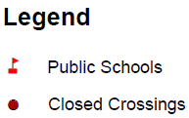
Sample - Closed Crossing Map
Double check these crossings to insure they are not identified as an active crossing in Maris

Slide 7
Information Needed
The basic info you need to create a warning:
Node 1 Node 2 Warning Message
For railroad crossings you need 2 items:
Node 1 Node 2 ** RR XING** DOT # - provided on the maps

Slide 8
Pieces of the Puzzle
Maps from DOT show railroad numbers in their system
For their report, they need that number and it is clearly noted on the new maps that are in your 2016 Railroad File on FTP

Slide 9
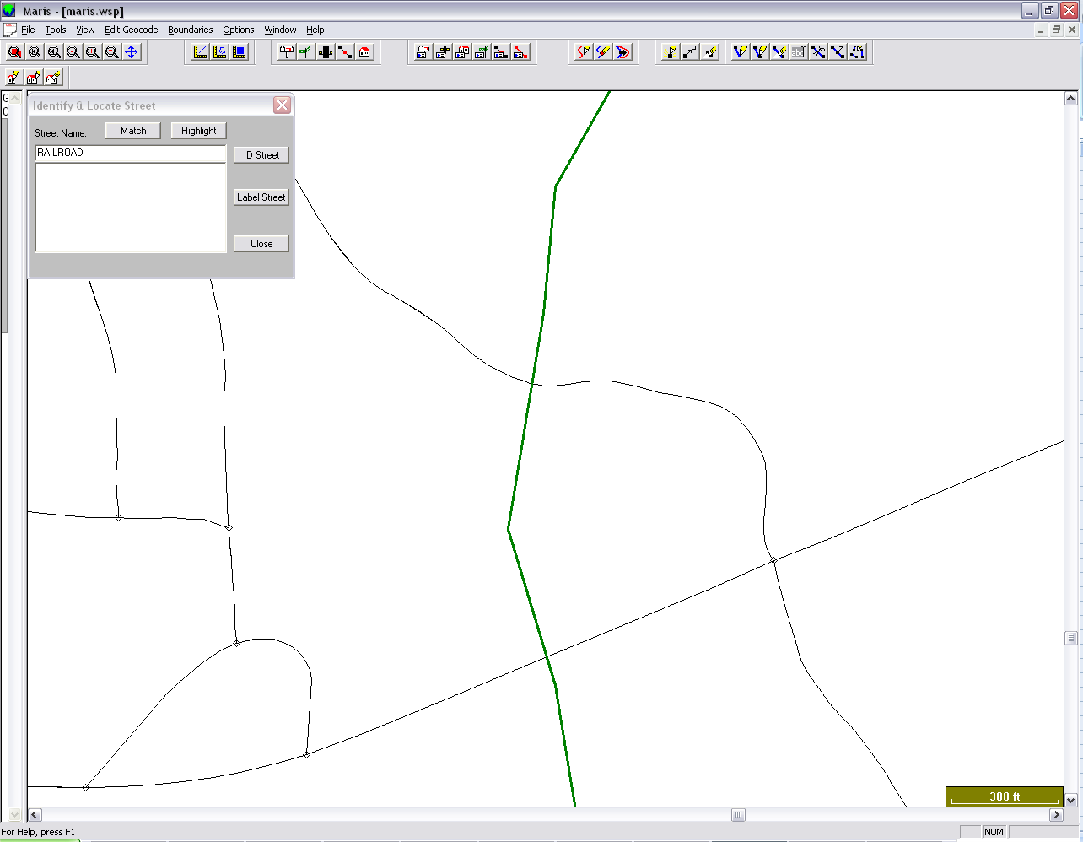
Proper Railroad Node Placement in MARIS
Split the Street Segment at Three Locations
Before the Crossing
At the Crossing
After the Crossing
Document the Node Numbers for later use

Slide 10
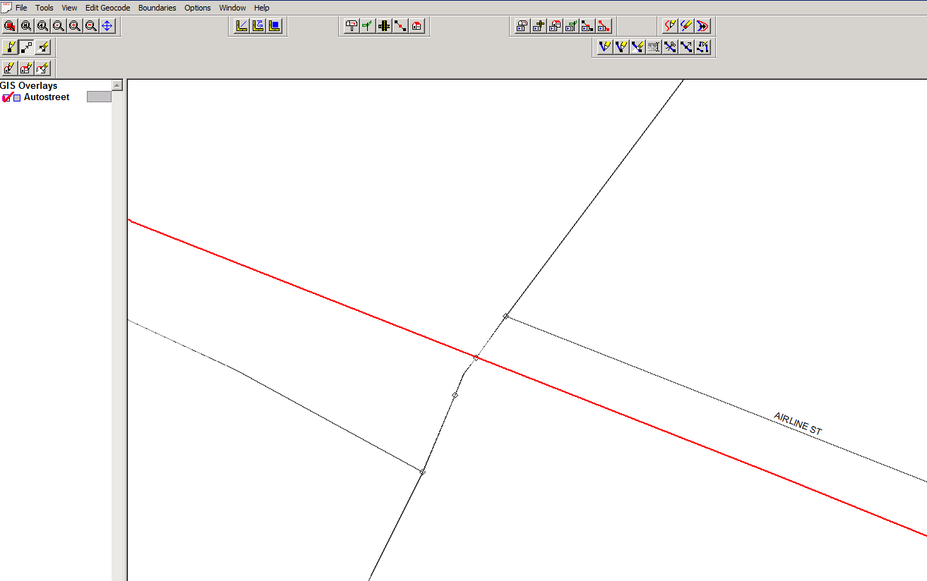
How it will look in Maris with segments split to note a Railroad Crossing
Railroad Crossing Placement
Crossing ID: 23895J
In this example, the bus could possibly cross at these node numbers:
5742 – 5743
5743 – 5744
5744 – 5743
5743 - 5742
5742
5743
5744

Slide 11
Updating the RRCRS.DAT File
After correctly splitting street segments and checking existing crossings, you are now ready to update the RRCRS.DAT File
By updating this file, you are making the railroad crossing information available in reports
Once the warnings are loaded using Buildtxt and running system maintenance, the Railroad Warnings will appear in printed Driver Directions.
The RRCRS Report, sent to NCDOT, will include the number of students who pass over the Railroad Crossing each day

Slide 12
DOT#
This is what the file looks like outside of Buildtxt; see the spacing between node numbers and the DOT number
The RRCRS.DAT File lists each crossing twice, to account for a bus crossing the Railroad from either direction.
Notice the design and format of each line of text.
It is very important to maintain the exact spacing to ensure the correct information is captured; using Buildtxt to make the edits insure proper spacing.

Slide 13
The order of the node number is important as it indicates the direction that the bus is travelling.
Example here - for the first line (5749 5747 **RRXING** 57268K), indicates the bus is travelling from node 5749 to node 5747, then it is to cross the railroad where the message **RRXING** 57268K will appear in driver directions.

Slide 14
Examine Current RRCRS File
Using Launch Pad, Open BuildTxt.exe
Take look at the current file for RRcrs; choose EDIT RRcrs

Slide 15
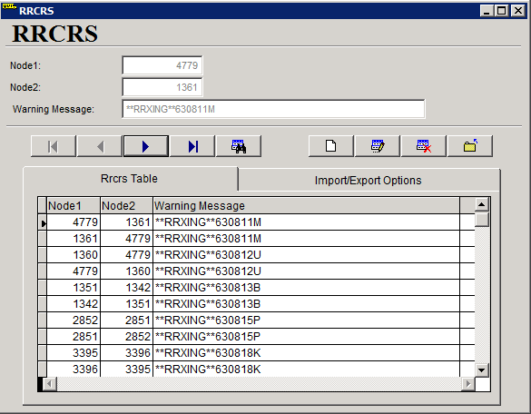
What RRCRS file should look like in BuildTXT

Slide 16
Browse through this table and double check that the changes you made are reflected
Select Exit Form when finished
Run the following EMU Batches
Rebuild Keys
Geocode Map Maintenance
Stop Scan (if needed)
Batch RTE Directions
Dumpall

Slide 17
Buildtext
All editing is done in the top fields
This program only builds the file
It must be exported before the system can use it
The tabs show the table and the import/export functions

Slide 18
Next Steps
There will be an upcoming Webinar to fully discuss these steps
Download your maps from FTP – they will be located in a folder named “2016 Railroad Maps”
TIMS project leaders are prepared to assist you in reviewing this project

